Slide 1

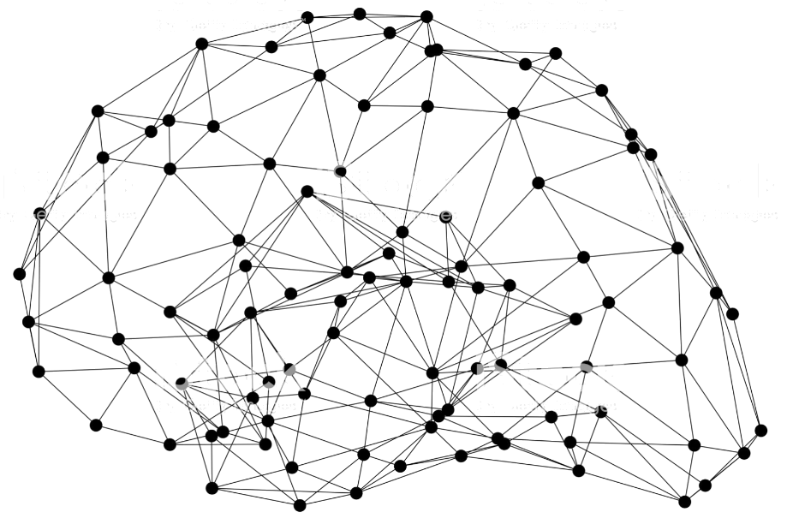
Object Detection using GluonCV
Notes:
First call deck for a high level introduction to Apache MXNet.

Slide 2
Object Detection

Slide 3
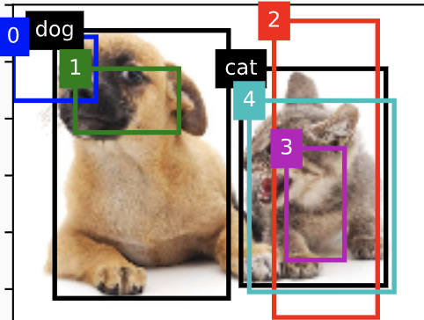
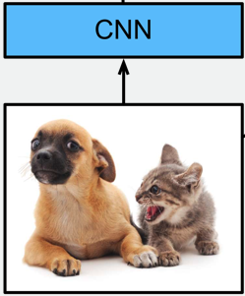
Popular models of object detection
Anchor Based
Anchor-free
RCNN series
SSD
YOLO series
…
FCOS
FoveaBox
CornerNet
CenterNet
…

Slide 4
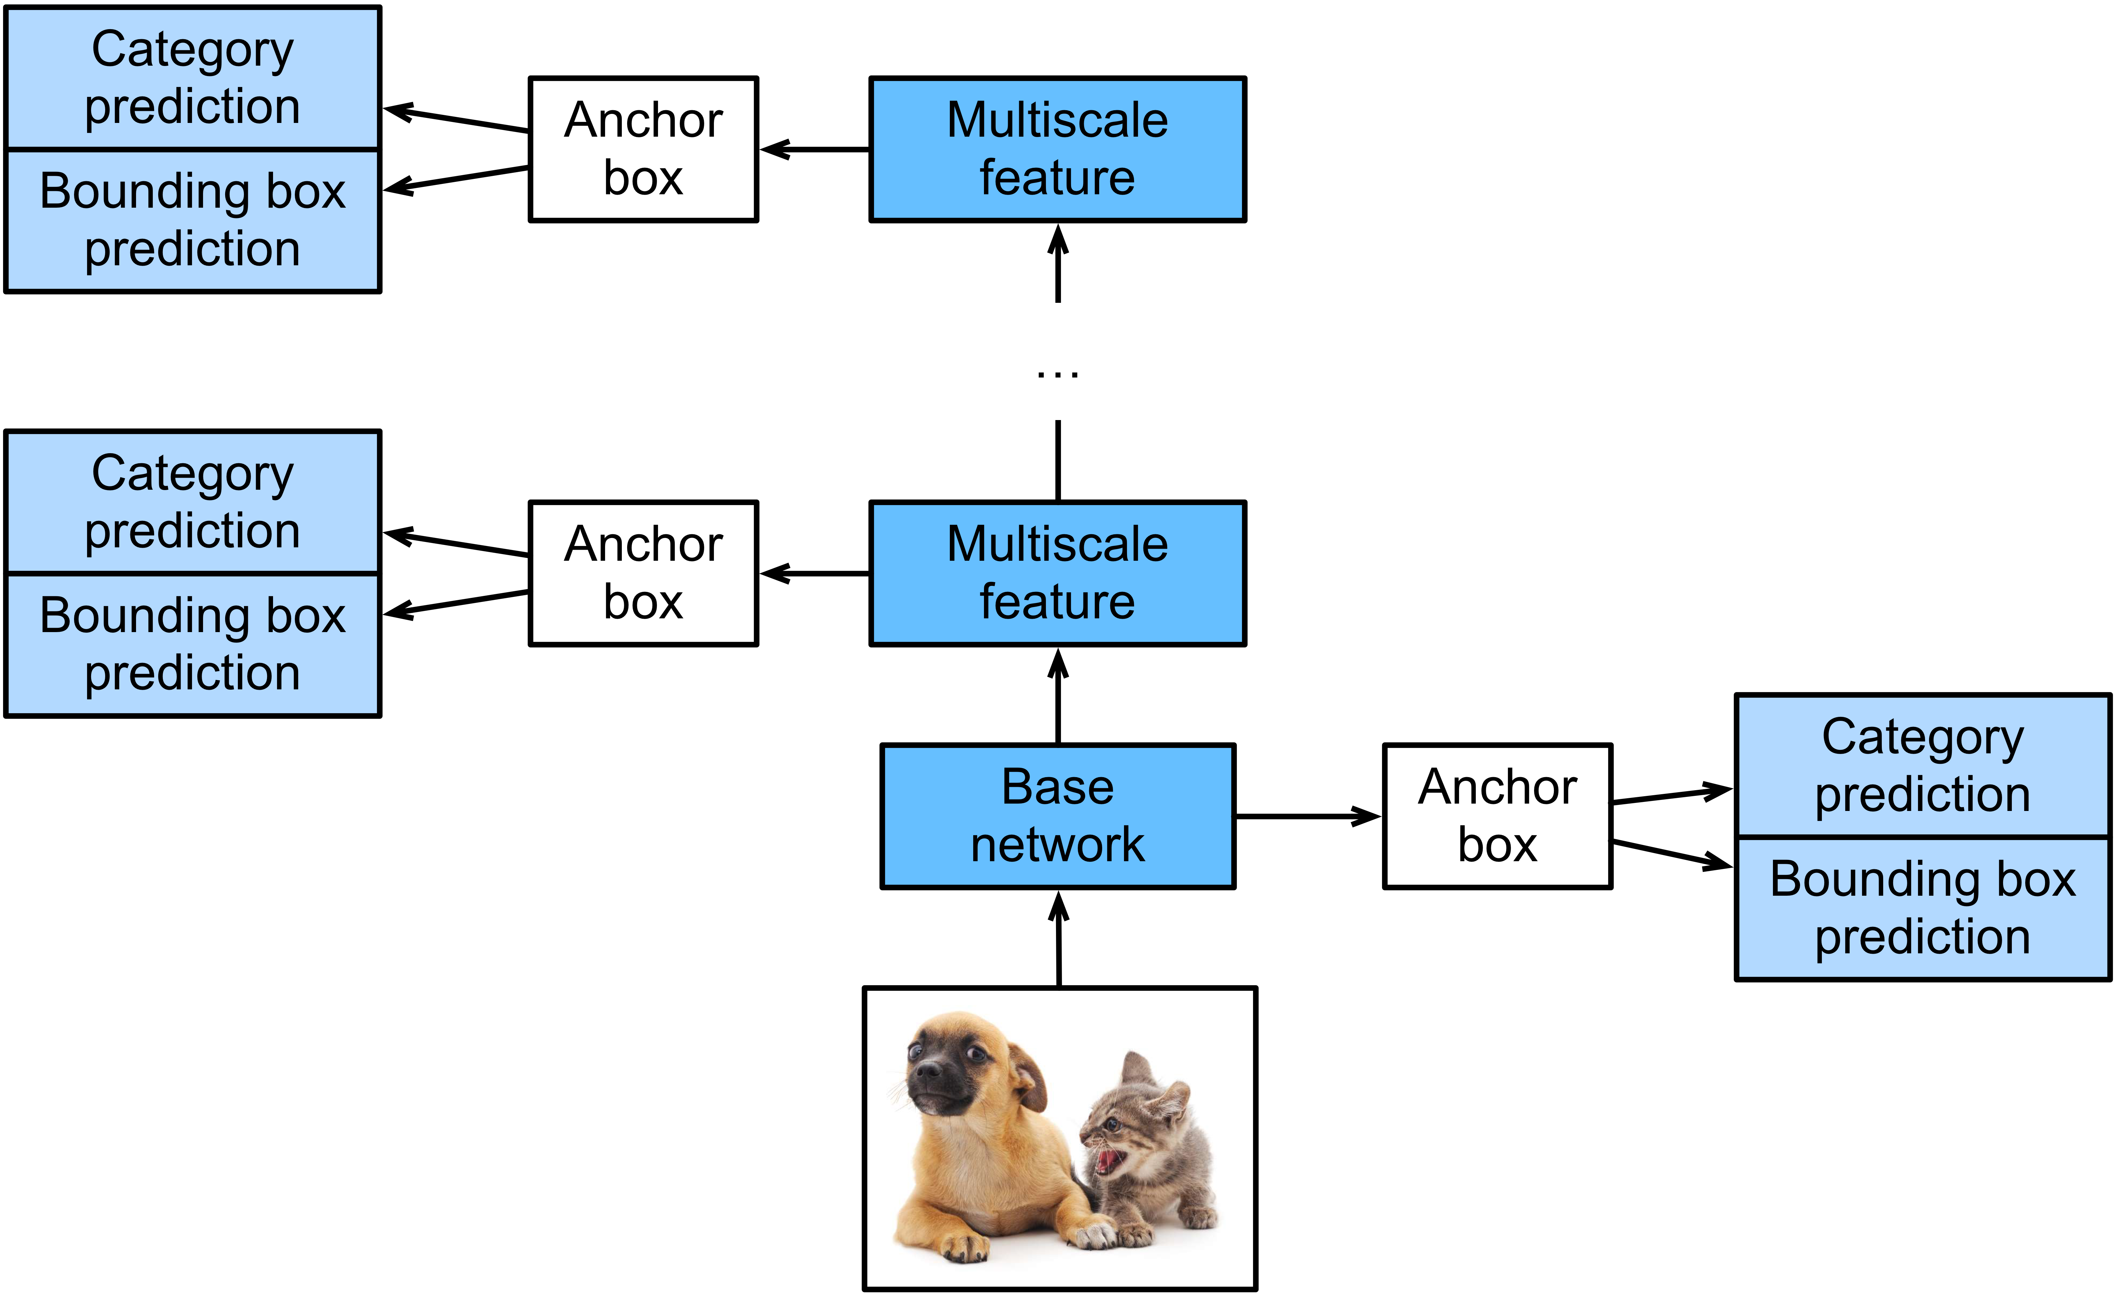
Popular models of object detection
SSD: Single Shot Multibox Detector
[1]Wei Liu, Dragomir Anguelov, Dumitru Erhan, Christian Szegedy, Scott Reed, Cheng-Yang Fu, Alexander C. Berg. SSD: Single Shot MultiBox Detector. ECCV 2016.

Slide 5
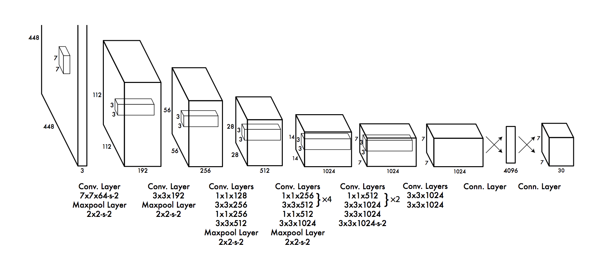
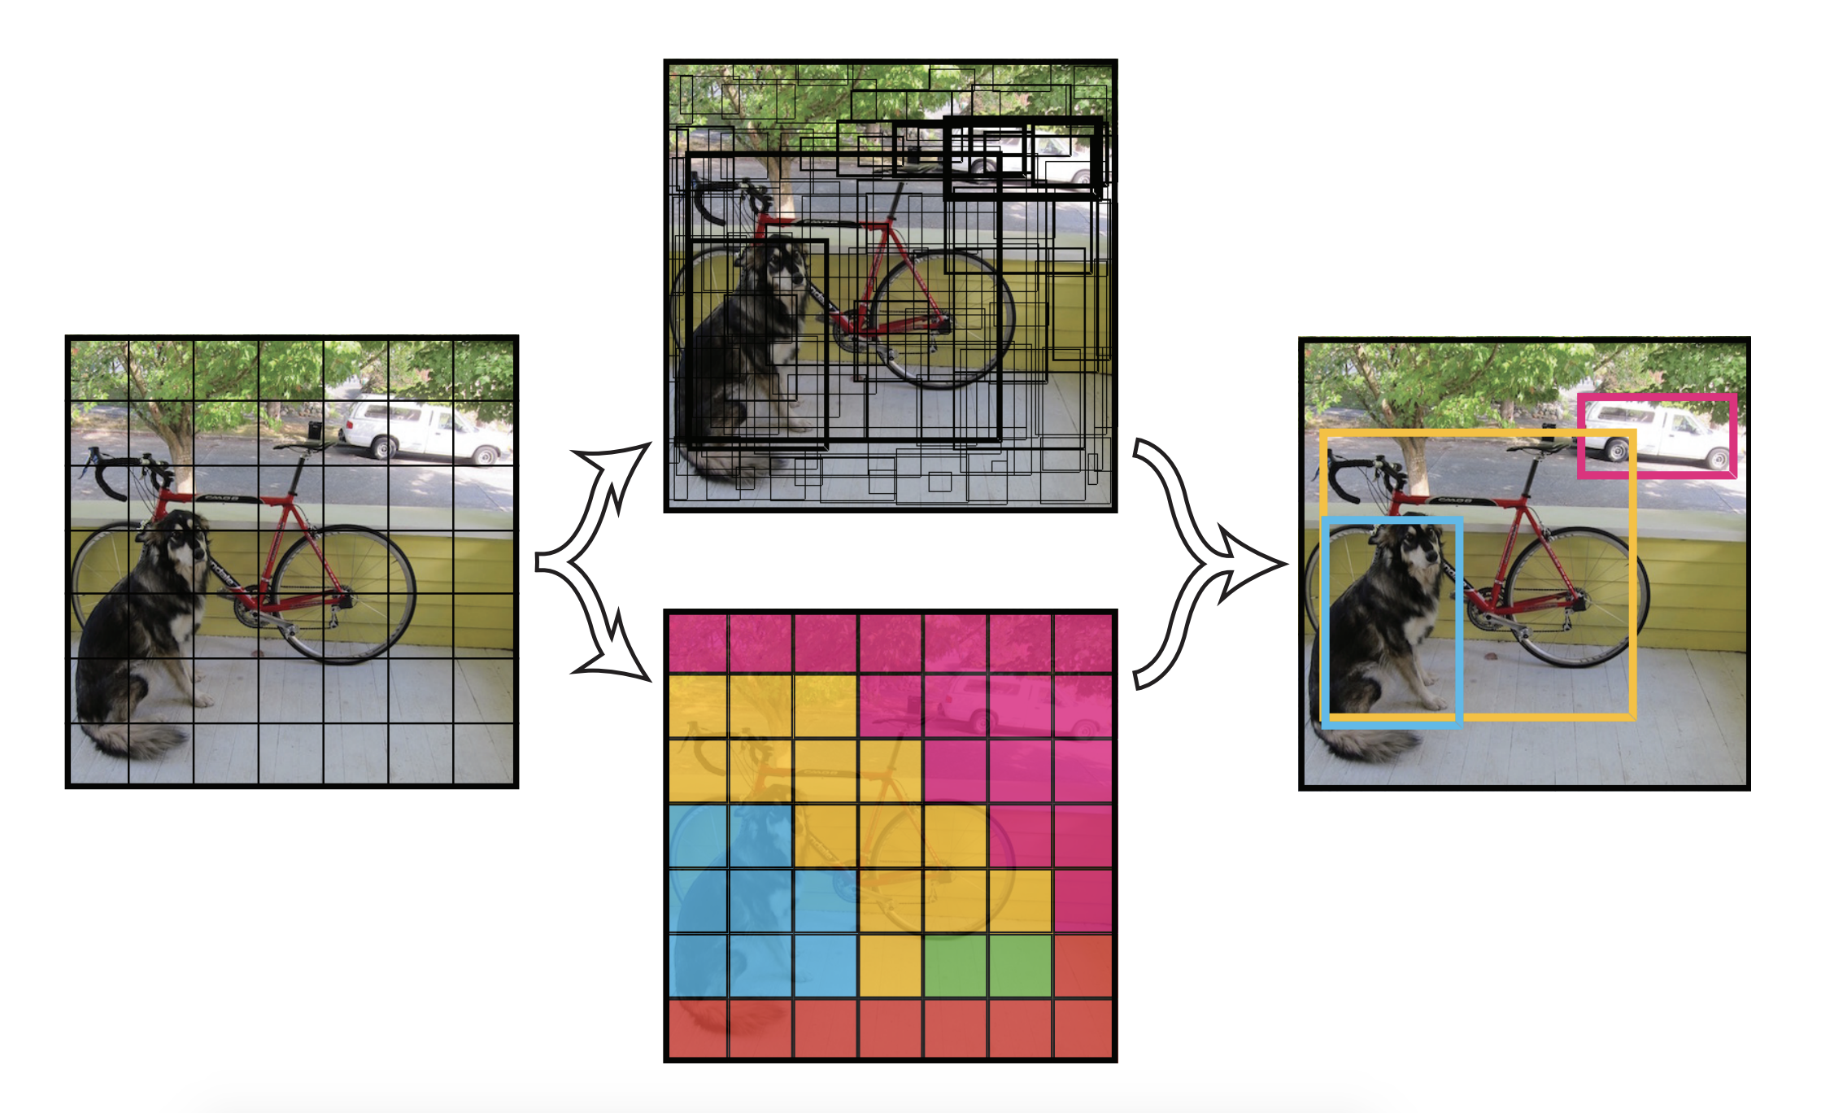
Popular models of object detection
YOLO v1-v3
[2]Redmon, Joseph, et al. "You only look once: Unified, real-time object detection." Proceedings of the IEEE conference on computer vision and pattern recognition.2016.

Slide 6
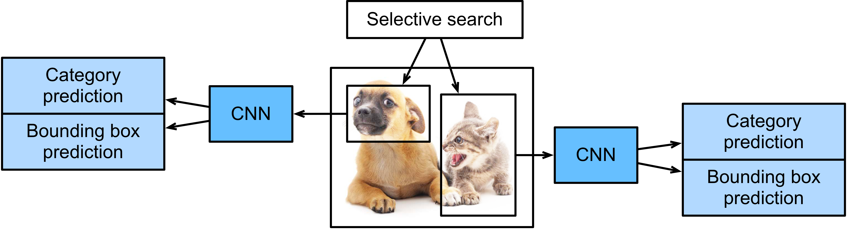
Popular models of object detection
R-CNN
Selective search is slow
Class prediction by SVM
[3] Girshick, Ross, et al. "Rich feature hierarchies for accurate object detection and semantic segmentation." Proceedings of the IEEE conference on computer vision and pattern recognition. 2014.

Slide 7
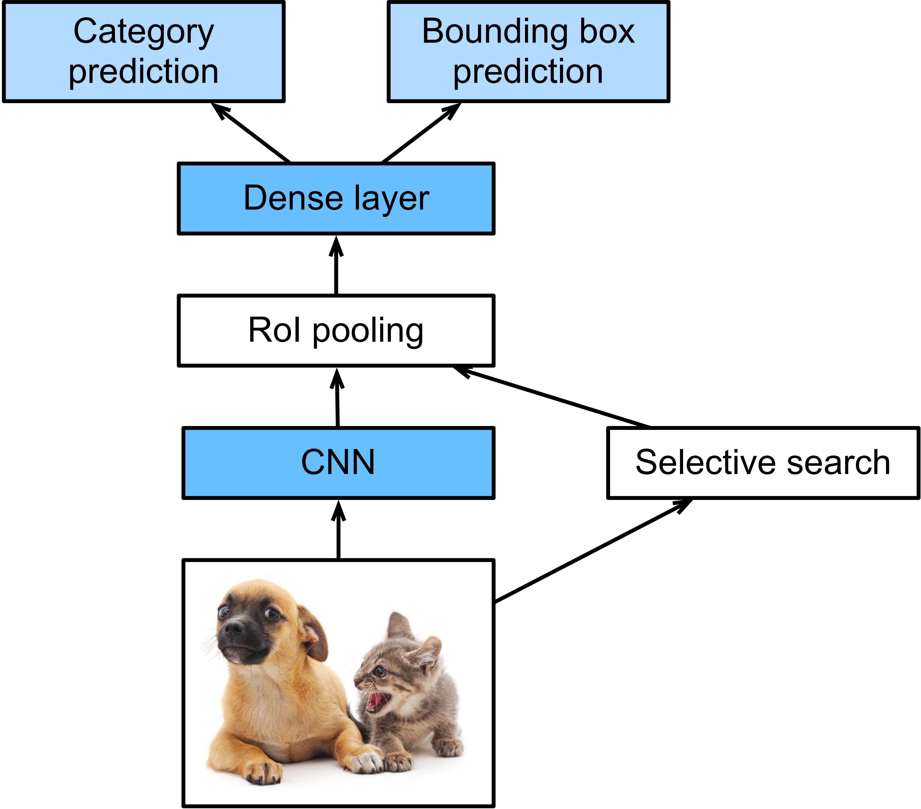
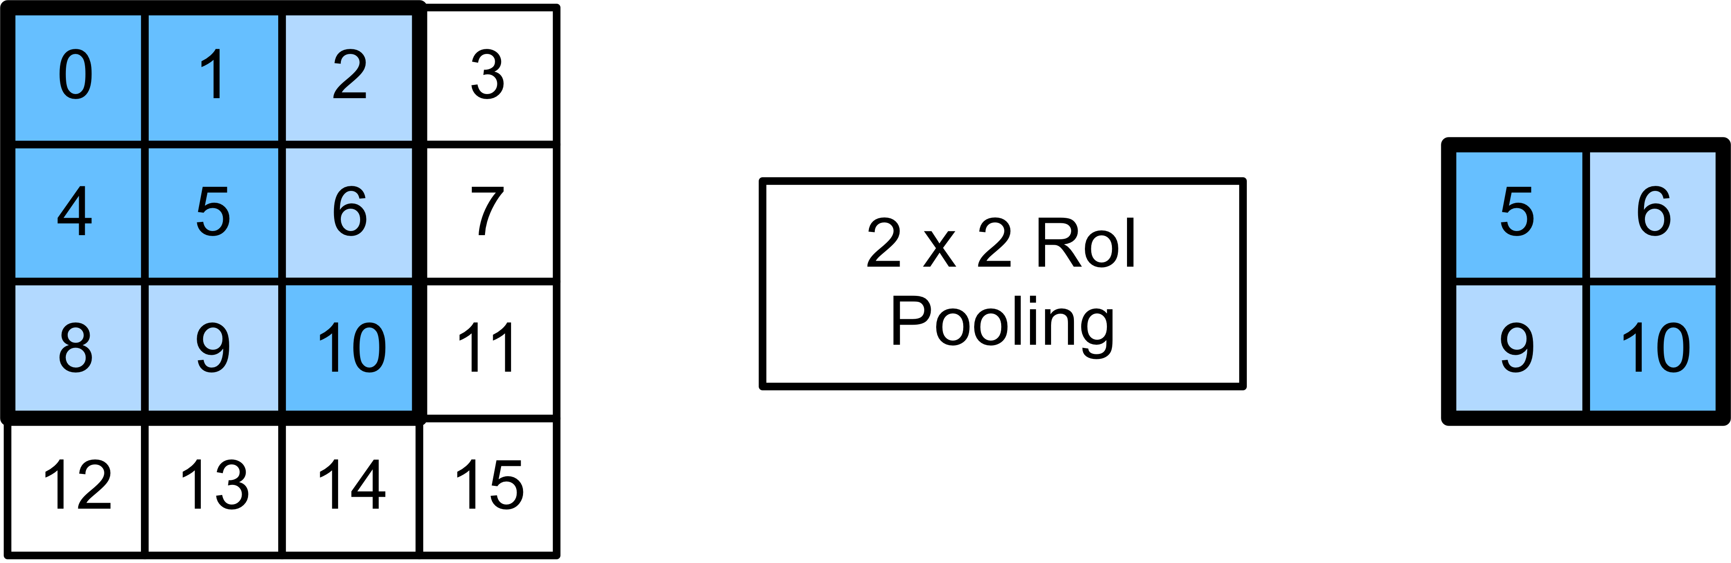
Popular models of object detection
Fast R-CNN
RoI Pooling
Prediction in dense layer
[4] Girshick, Ross. "Fast r-cnn." Proceedings of the IEEE international conference on computer vision. 2015.

Slide 8
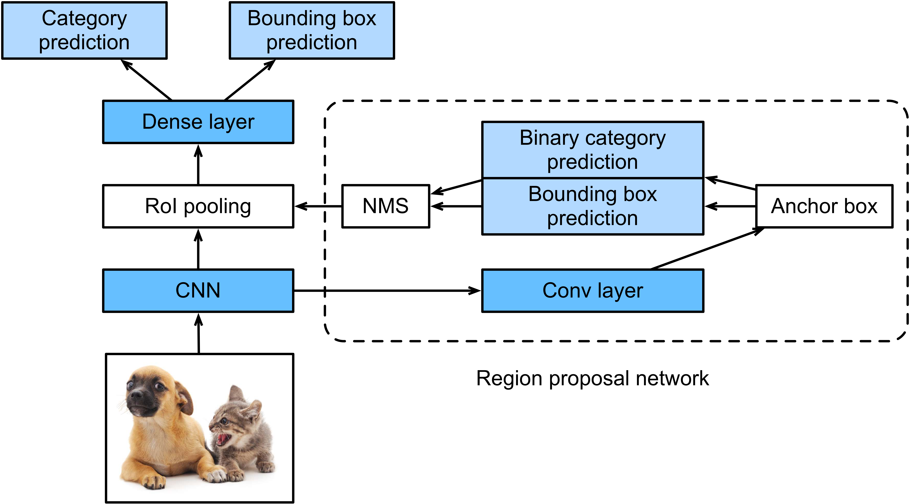
Popular models of object detection
Faster R-CNN
Replace selective search by region proposal network
[5] Ren, Shaoqing, et al. "Faster r-cnn: Towards real-time object detection with region proposal networks." Advances in neural information processing systems. 2015

Slide 9
Evaluating object detection models
Bounding Box
Generated by model
Represented by e.g. (x, y, w, h)

Slide 10
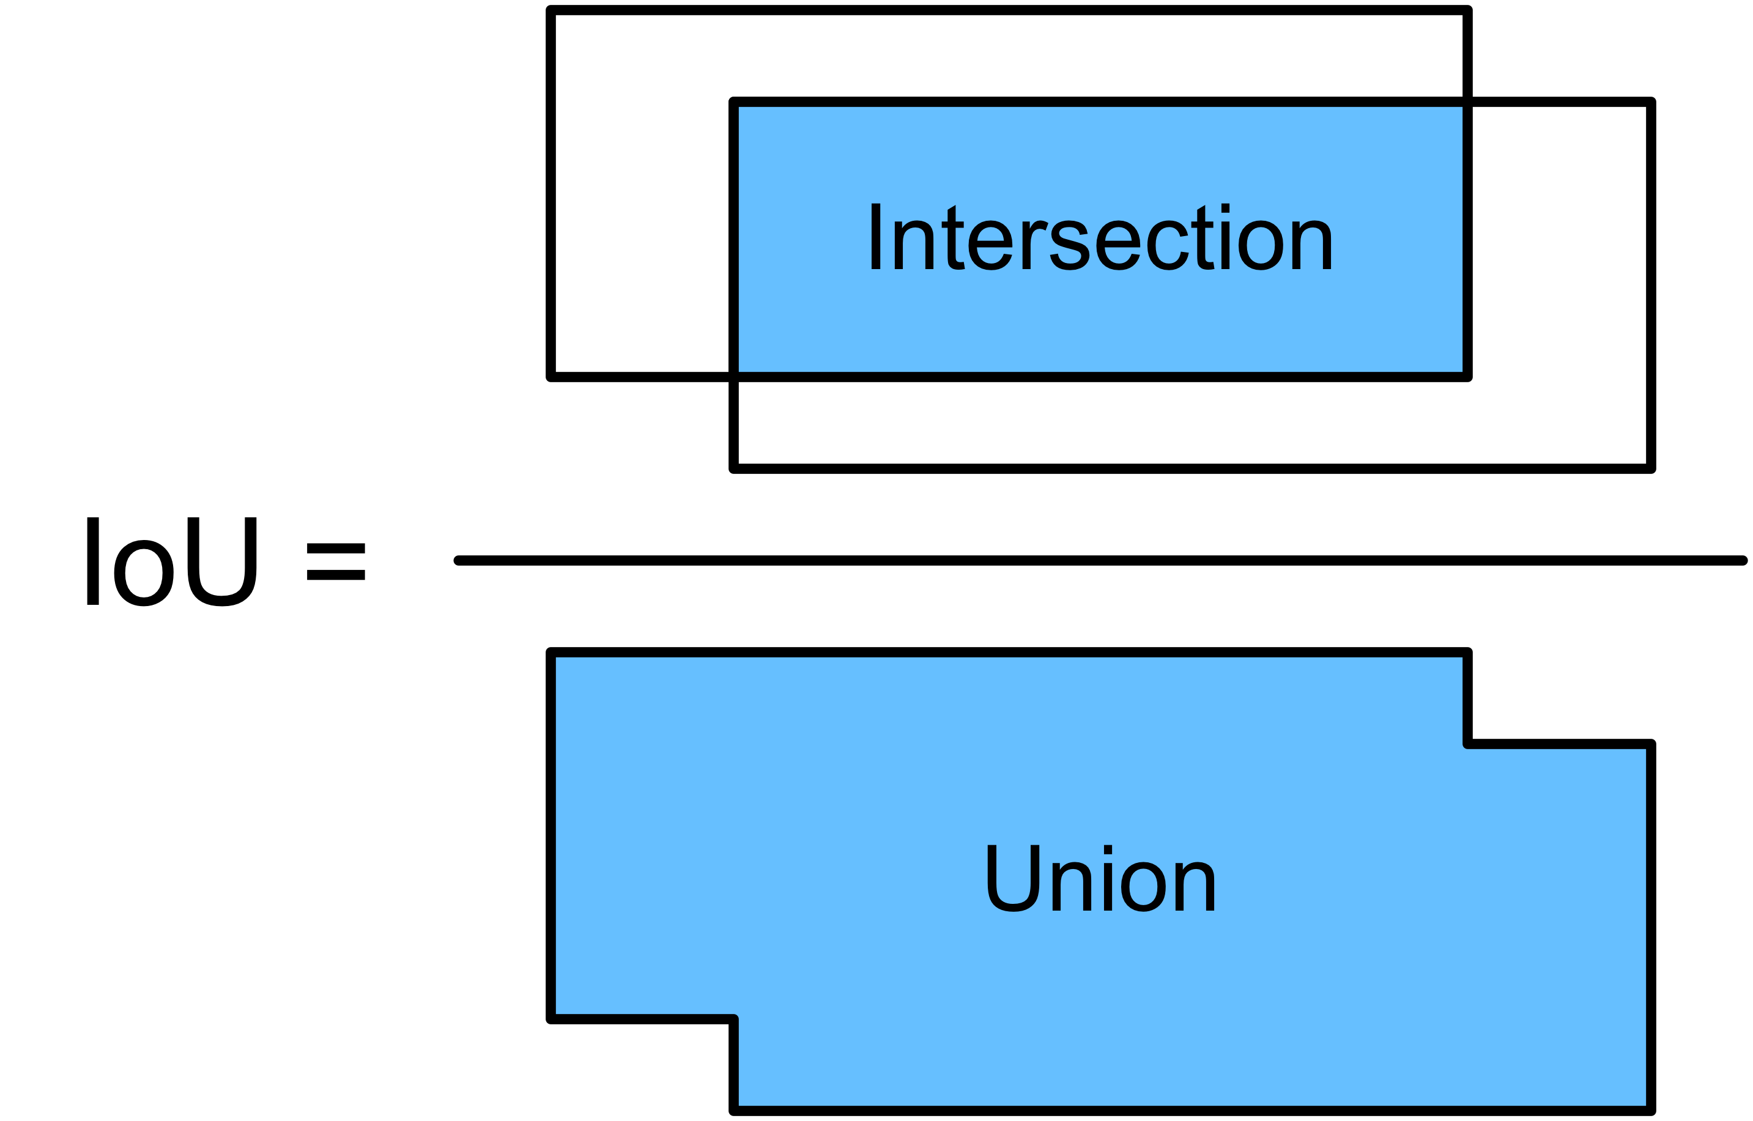
Evaluating object detection models
IoU: Intersection over Union

Slide 11
Implement SOTA Detection Models with GluonCV
Method | Metric | GluonCV | Reference
YOLOv3 | mAP on COCO | 37.0% | 33.0%(paper)
Faster-RCNN-Resnet50 | mAP on COCO | 37.0% | 36.5%(Detectron)
Faster-RCNN-Resnet101-FPN | mAP on COCO | 40.8% | 39.8%(Detectron)
SOTA pre-trained models(single model, single scale test)

Slide 12
Implement SOTA Segmentation Models with GluonCV
Data API
Automated data preparation
Dataset specialized for bbox
Transformation API
Metric API
Loss API
Pre-defined network architectures
Building-blocks
Custom Layers
Reproducible Experiments
Training Script
Configurations
Available in GluonCV

Slide 13
Advanced training approaches included in GluonCV
Label Smoothing
One hot: (0, 1, 0, 0, 0)
Smoothed: (0.01, 0.96, 0.01, 0.01, 0.01)
Prevent overfitting!
[6]Müller, Rafael, Simon Kornblith, and Geoffrey Hinton. "When Does Label Smoothing Help?." arXiv preprint arXiv:1906.02629 (2019)

Slide 14
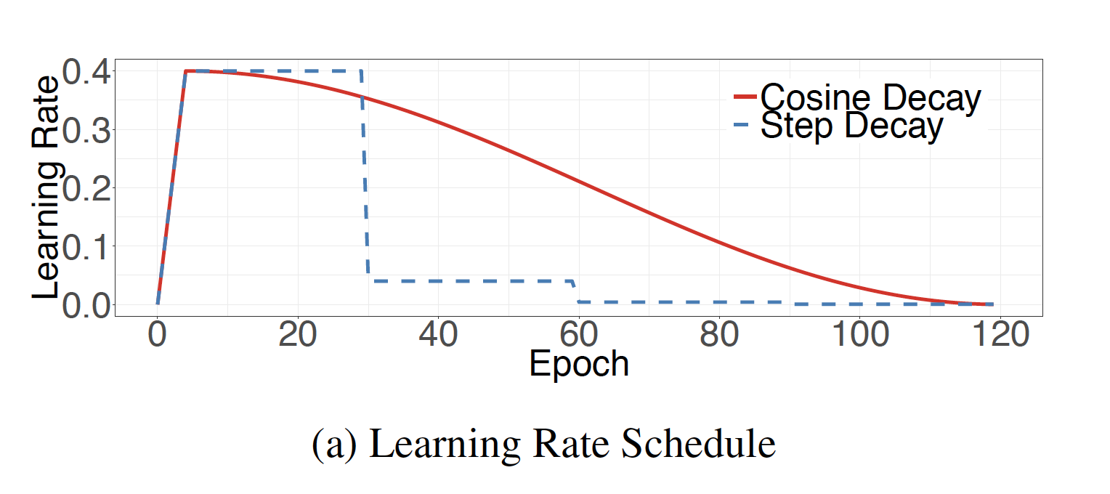
Advanced training approaches included in GluonCV
Learning Rate Schedule
Step
Cosine
Poly
Combine with Warmup

Slide 15
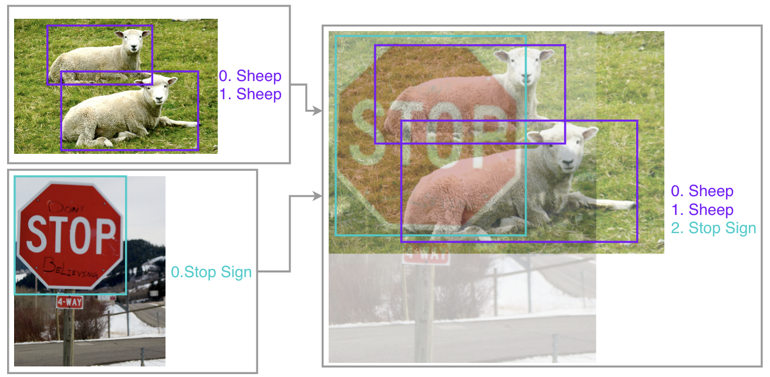
Advanced training approaches included in GluonCV
Mixup for object detection
Zhang, et al. "Bag of freebies for training object detection neural networks." arXiv preprint arXiv:1902.04103 (2019).

Slide 16
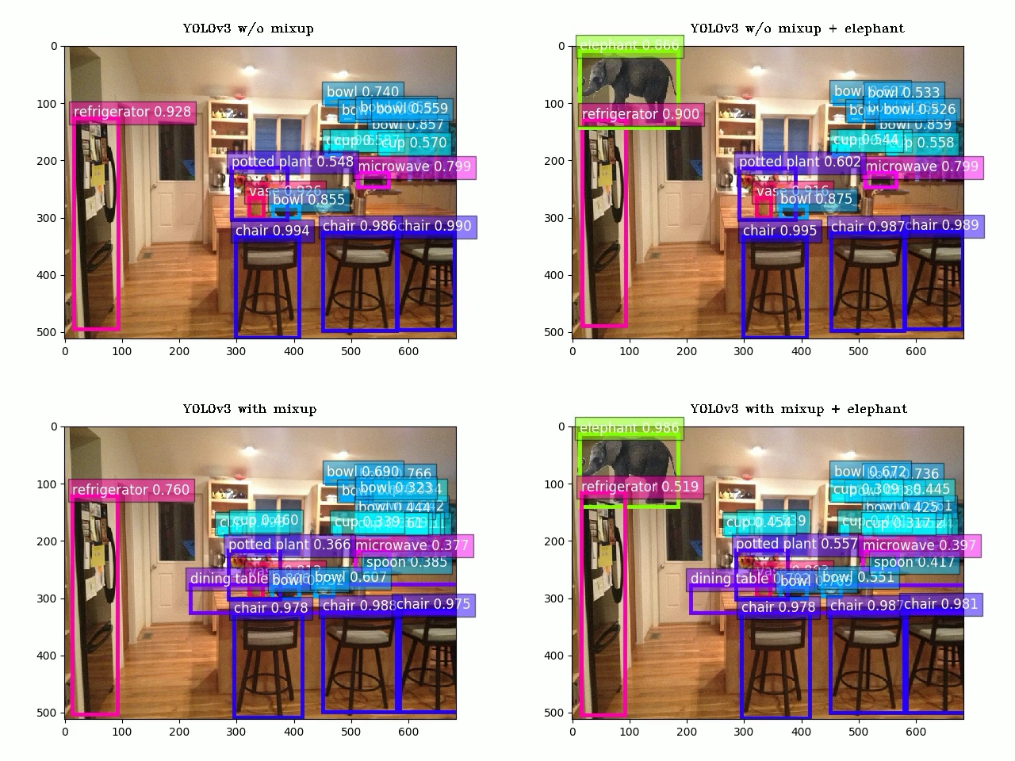
Advanced training approaches included in GluonCV
Mixup for object detection
Significantly improved robustness of models to unprecedented scenes
Zhang, et al. "Bag of freebies for training object detection neural networks." arXiv preprint arXiv:1902.04103 (2019).

Slide 17
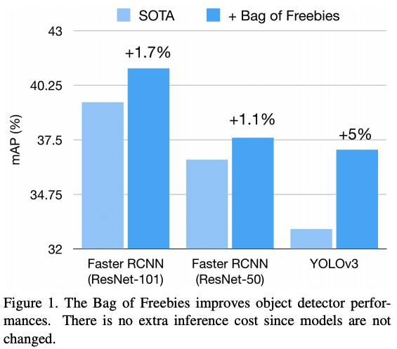
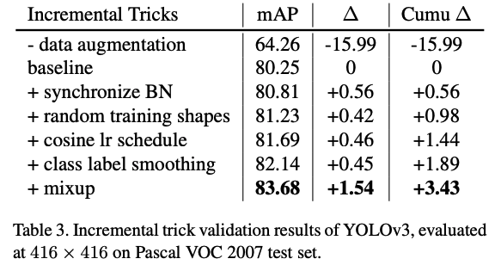
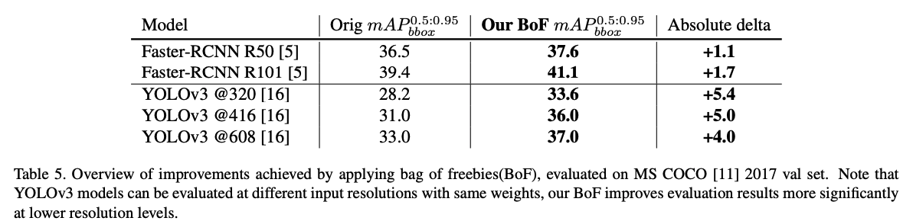
Advanced training approaches included in GluonCV

Slide 18
Hands On!

Slide 19

Like GluonCV? Go build!
https://github.com/dmlc/gluon-cv
https://gluon-cv.mxnet.io

